Slide 1
ANLY 605: Bird Feather Classification
Daniel Cisek, Jacob McIntosh
12/1/2022

Slide 2
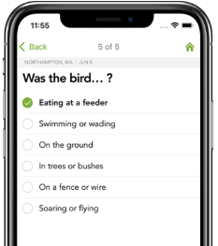
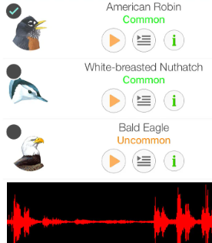
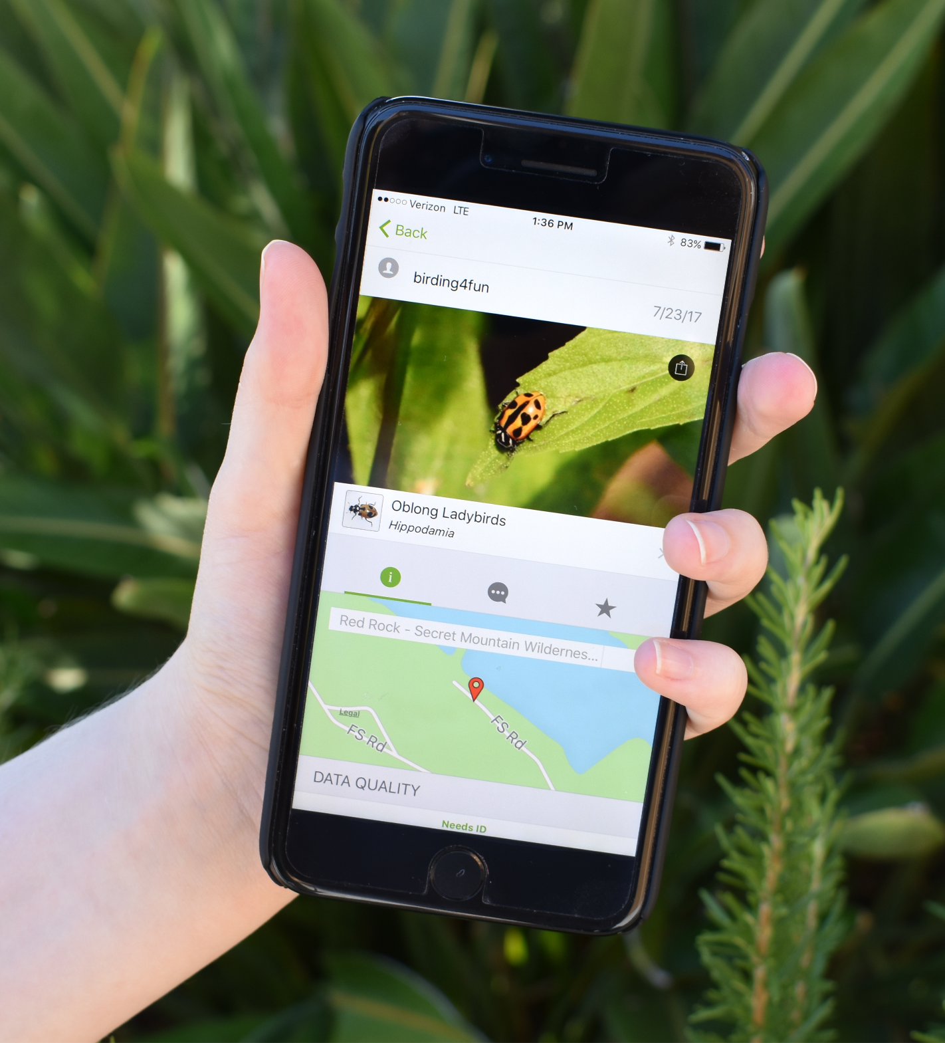
Background
Applications of Machine Learning in Conservation have grown rapidly in the past few years
Merlin ID Wizard (Contextual Search)
SongSleuth (Audio Classification)
iNaturalist (Image Classification)

Slide 3
Background
Applications of Computer Vision in Conservation have grown rapidly in the past few years
Merlin ID Wizard (Contextual Search)
SongSleuth (Audio Classification)
iNaturalist (Image Classification)

Slide 4
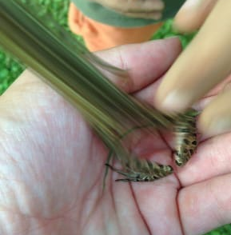
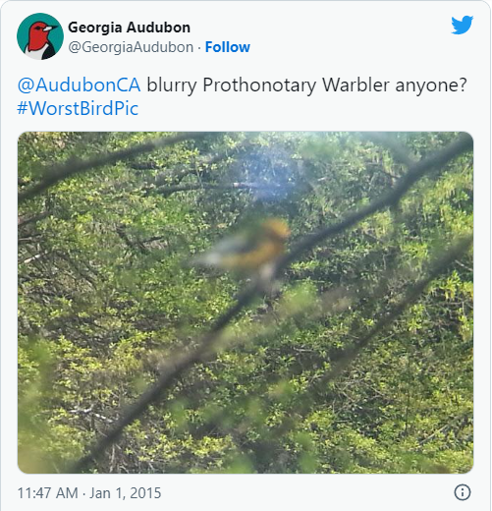
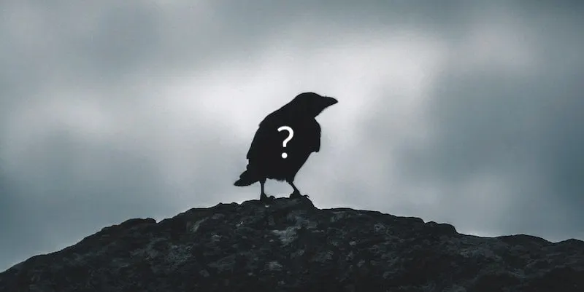
These apps have limitations
Animals don’t like to sit still
What if we’re not there at the same time as the animal?
Size, Distance, Speed often make photography difficult
#WorstBirdPic

Slide 5
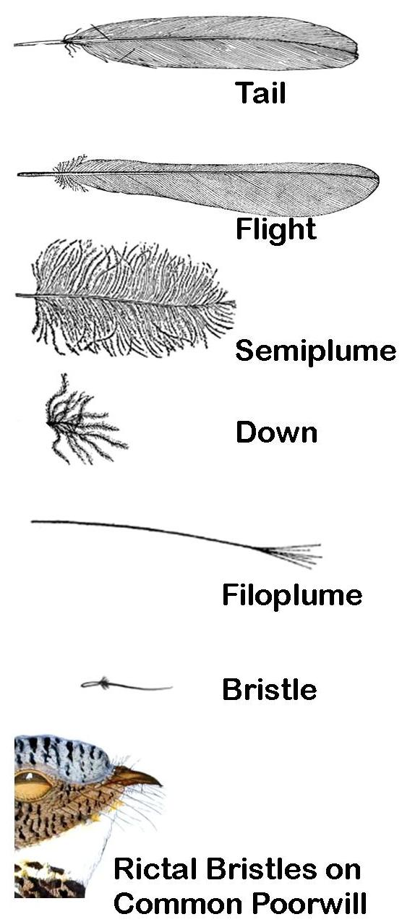
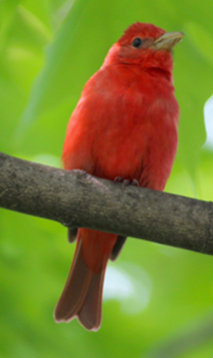
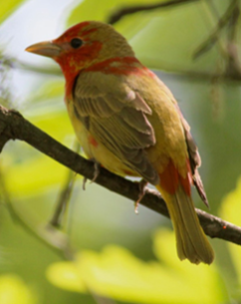
Feathers as a proxy
Feathers persist in the absence of a bird, thus serving as an effective indicator of presence
However, determining species from a feather is difficult because:
Feathers of a single species can vary significantly in shape and color depending on type (6x)
Sex, age, and seasonal molting greatly affect appearence
Difference between feathers of different species can be low, especially in the same order and genus

Slide 6
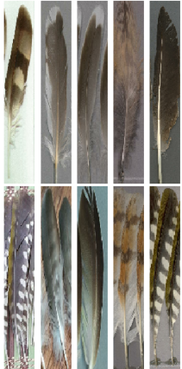
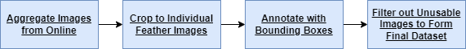
Feathers dataset for Fine-Grained Visual
Categorization
A paper published in 2020 attempted to solve this problem, presenting the first publicly available dataset of bird plumage for machine learning
Aggregated pictures from collectors, social media, and other sources to form this dataset, resulting in a corpus of 28,272 images across 595 species (avg. 11.03 pictures/species)
Trained a DenseNet model on the dataset as an initial benchmark, to encourage other work on this topic

Slide 7
Project Goals
Train a CNN to improve the accuracy of their DenseNet based approach
Make a web application to improve the accessibility of their solution and add additional functionality
Wikipedia Information
Use the Wikipedia package (MediaWiki API) to link users to a species’ Wikipedia page, providing an avenue for users to learn more.
Integrated Taxonomic Information (ITIS)
Utilize the ITIS API to return species information, translate Binomial/Latin name to English, and provide other useful context to users.

Slide 8
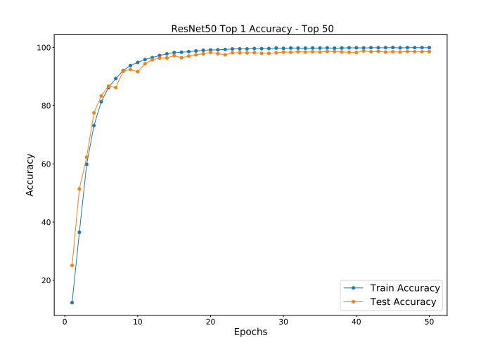
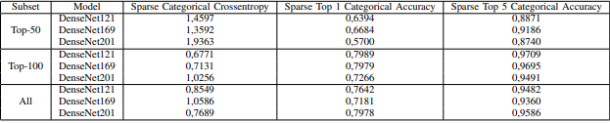
Model Training
Switched to a ResNet-50 based approach to:
Save storage space for model deployment
Not have to rely on DenseNet’s extensive GPU requirements
Leverage this architecture’s history of achieving high pixel-level accuracy on visually complex tasks
Top 1 Accuracy: 98.79%

Slide 9
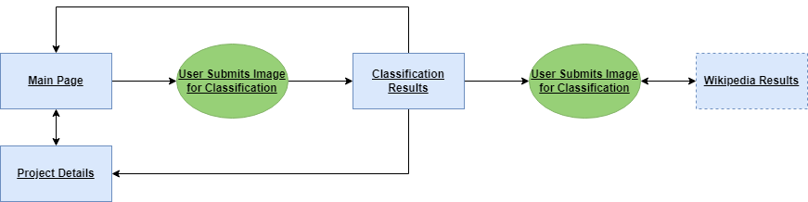
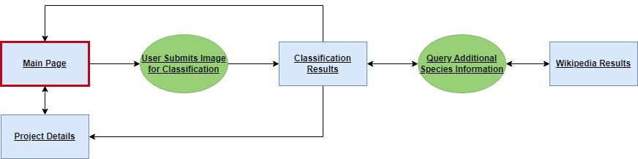
User Flow Diagram

Slide 10
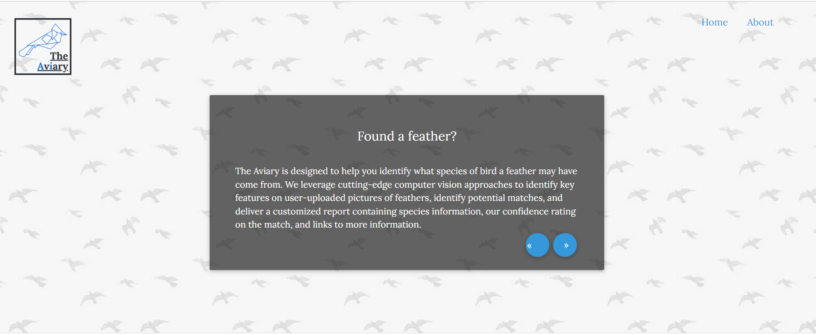
User Flow Diagram

Slide 11
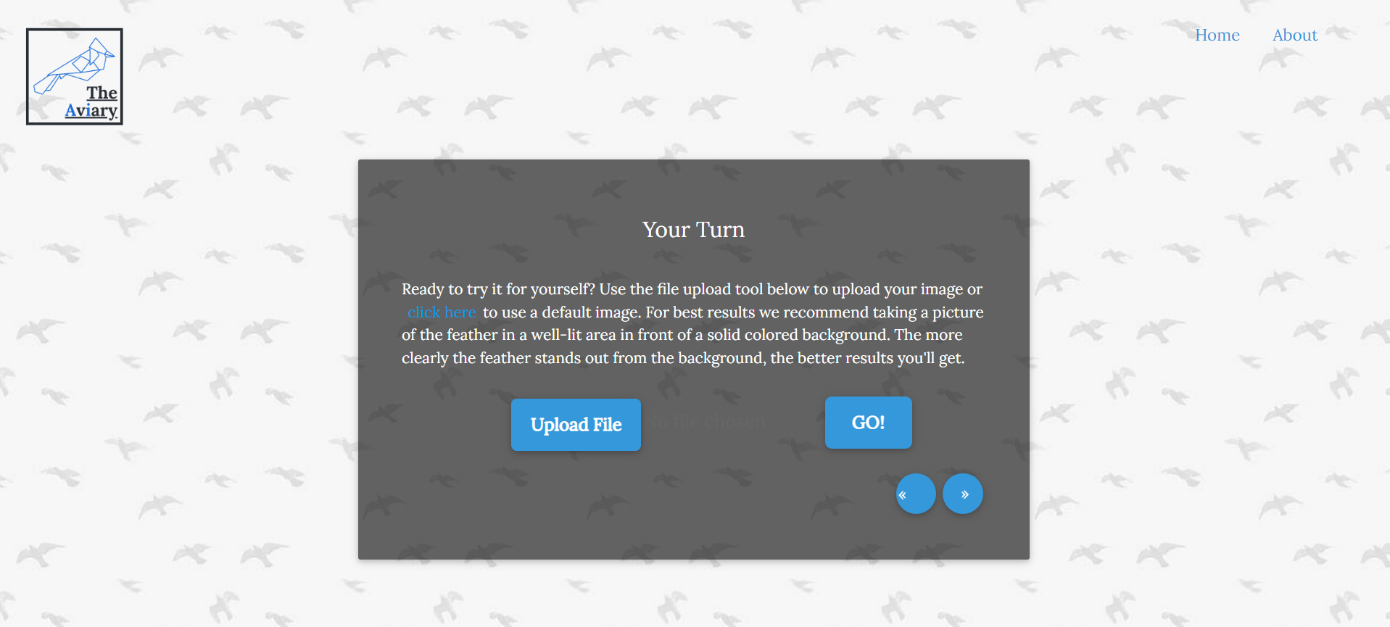
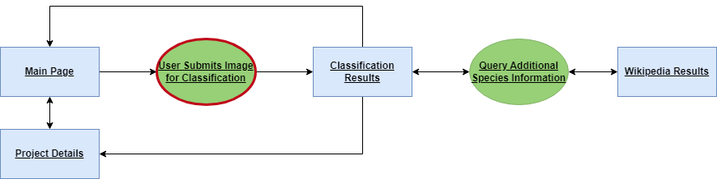
User Flow Diagram

Slide 12
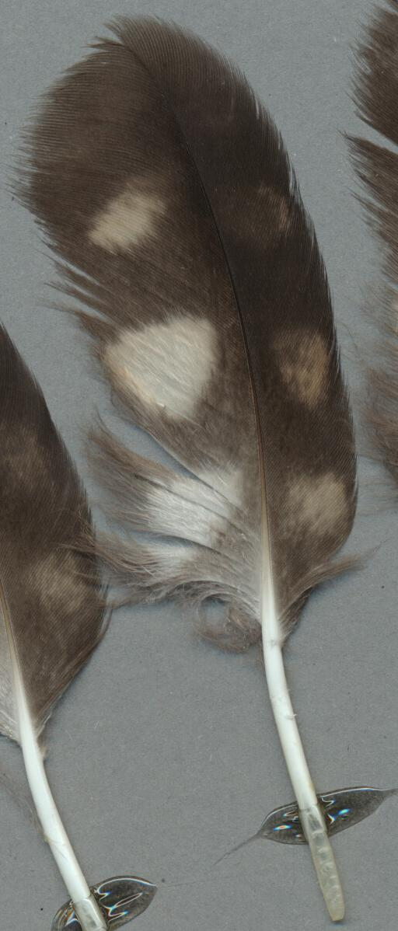
User Flow Diagram
Short-Eared Owl

Slide 13
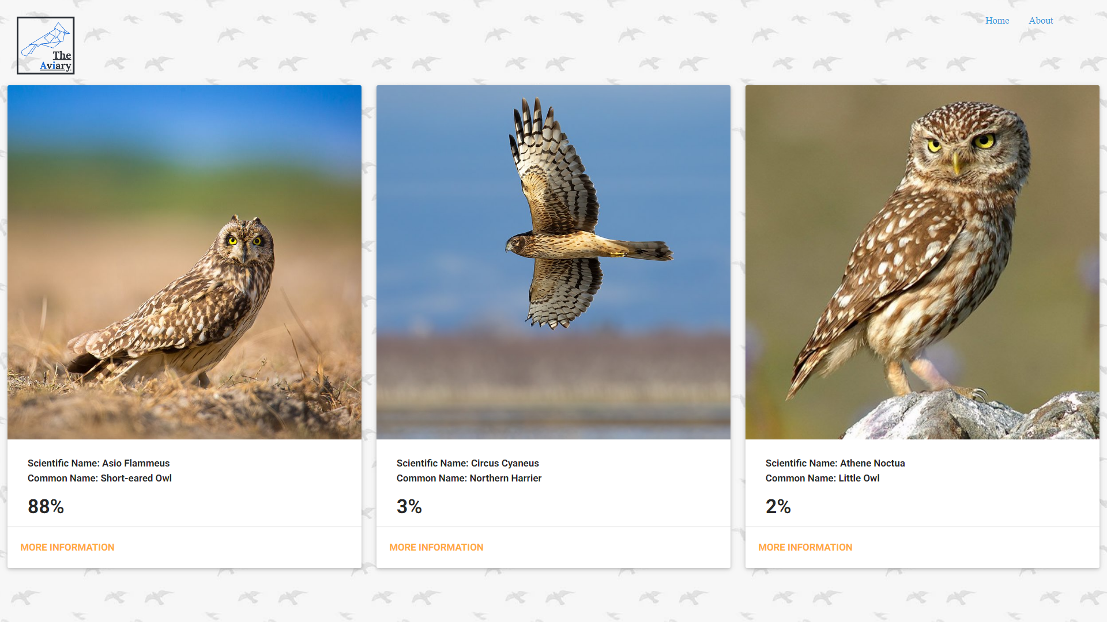
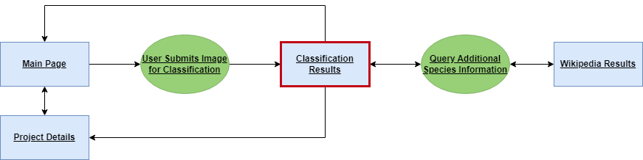
User Flow Diagram

Slide 14
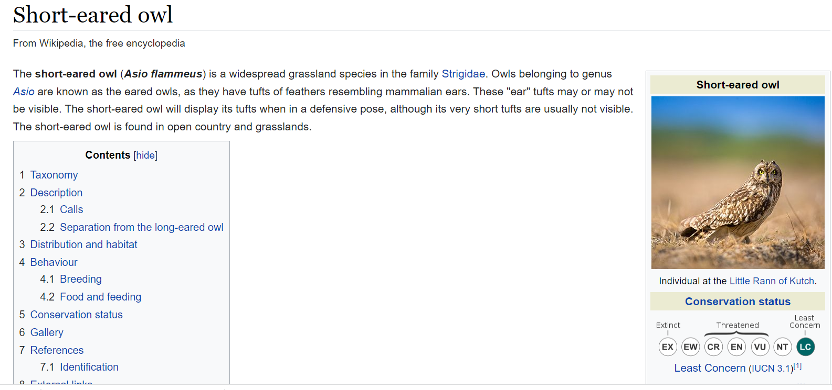
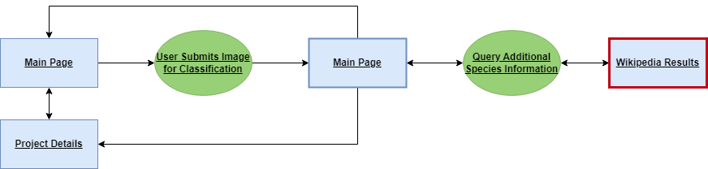
User Flow Diagram

Slide 15
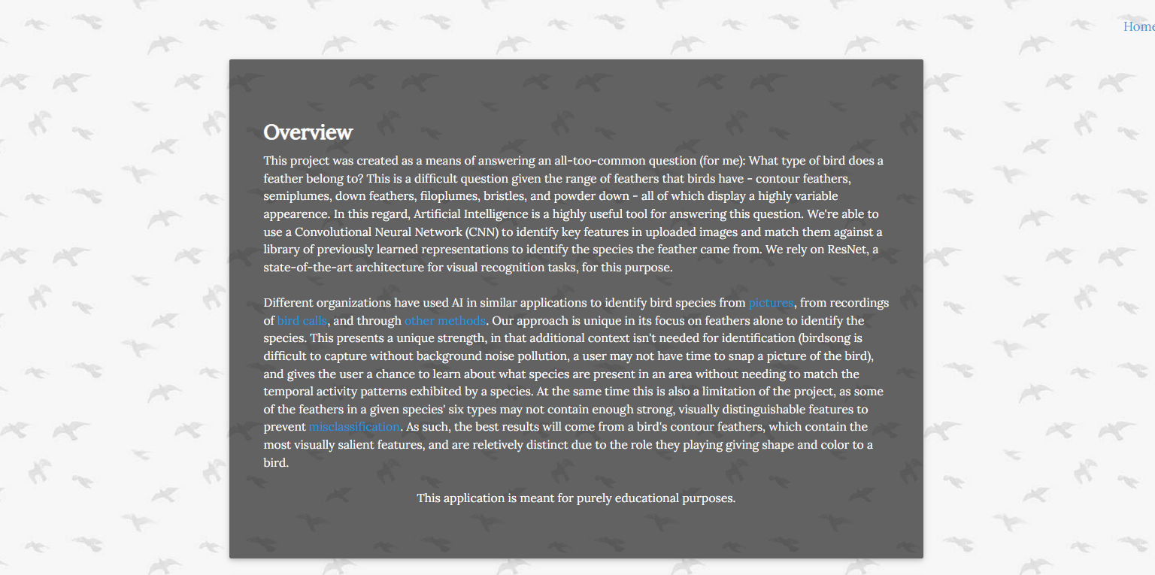
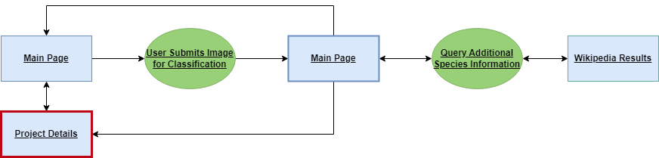
User Flow Diagram

Slide 16
Time for a demo!

Slide 17
Acknowledgements:
References
A big thank you to Professor Nakul, Jacob McIntosh, and Rui Qiu for their help during this project
ITIS: https://www.itis.gov/ws_searchApiDescription.html
Initial Feather Paper: https://arxiv.org/pdf/2004.08606.pdf
Types of Feathers: http://sheabirdno1.blogspot.com/2011/09/types-of-bird-feathers.html
Merlin ID Wizard: https://merlin.allaboutbirds.org/
SongSleuth: https://apps.apple.com/us/app/song-sleuth-bird-song-analyzer/id968399159
iNaturalist: https://www.inaturalist.org/

